Slide 1
Discrete Structure Predicate Calculus and Methods of Proofs
Week 9
By
Dr. Rafiullah Khan

Slide 2
Scenario
20 is greater the 10. (True or False)
6 is even number. (True or False)
Now
X is greater the 10. (True or False)
X is greater the Y. (True or False)
Can we decide?
We cannot use Propositional Logic here.

Slide 3
Predicate Calculus
Predicate calculus extends propositional logic by allowing predicates, quantifiers, and variables.
It contains all operations of Propositional Logic (∧∨→⌐ and other) and extends it with Quantifiers.
It enables reasoning about objects (Variable) and their relationships.
Example:
Propositional: ‘Socrates is mortal.’ → M
Predicate: ‘All humans are mortal.’ → ∀x
(Human(x) → Mortal(x))

Slide 4
Quantifiers and Syntax
Universal quantifier (∀): ‘For all’
Example: ∀x (Human(x) → Mortal(x))
Existential quantifier (∃): ‘There exists’
Example: ∃x (Student(x) ∧ Smart(x))
Variables, constants, predicates, and functions form atomic formulas.

Slide 5
Scenario Again
x is smaller the 10.
How we represent it now
P(x) = x is smaller the 10.
Now for the values of x
If X={1,2,3,4,6,8,9} (This is called Domian)
So according to Universal Quantifier:
∀ x (P(x)) = True
For all values of x, x is smaller then 10.

Slide 6
Scenario Again
What if the Domain values are different?
Domain ={1,2,3,4,6,8,9,15,20}
The we will use Existential Quantifier
∃ x (P(x)) = True
There exist at least 1 value which is greater the 10.

Slide 7
Rules of Inference
A rule of inference is a logical principle that allows us to draw valid conclusions from given statements (premises).
Modus Ponens (Law of Detachment)
Modus Tollens (Law of Contrapositive)
Hypothetical Syllogism
Disjunctive Syllogism
Simplification (∧ Elimination)
Conjunction (∧ Introduction)
Addition (∨ Introduction)
Resolution Rule

Slide 8
Rules of Inference
Rule Name | Form (Symbolic Representation) | Explanation / Example
1. Modus Ponens (Law of Detachment) | 1. ( P ) 2. ( P → Q ) ∴ ( Q ) | If P is true and P implies Q, then Q is true.Example: If it rains, the ground gets wet. It is raining ⇒ The ground is wet.
2. Modus Tollens (Law of Contrapositive) | 1. ( ¬Q ) 2. ( P → Q ) ∴ ( ¬P ) | If P implies Q, but Q is false, then P must be false.Example: If it rains, the ground gets wet. The ground isn’t wet ⇒ It didn’t rain.
3. Hypothetical Syllogism | 1. ( P → Q ) 2. ( Q → R ) ∴ ( P → R ) | Chain reasoning. Example: If I study, I pass. If I pass, I graduate ⇒ If I study, I graduate.
4. Disjunctive Syllogism | 1. ( P ∨ Q ) 2. ( ¬P ) ∴ ( Q ) | If at least one is true, and one is false, the other must be true.
5. Simplification | 1. ( P ∧ Q ) ∴ ( P ) or ( Q ) | From a conjunction, either part can be taken as true.
6. Conjunction | 1. ( P ) 2. ( Q ) ∴ ( P ∧ Q ) | Combine two true statements into one.
7. Addition | 1. ( P ) ∴ ( P ∨ Q ) | From a true statement, you can add any disjunction.
8. Resolution Rule | 1. ( P ∨ Q ) 2. ( ¬P ∨ R ) ∴ ( Q ∨ R ) | Eliminate a variable and combine clauses — used in automated theorem proving.

Slide 9
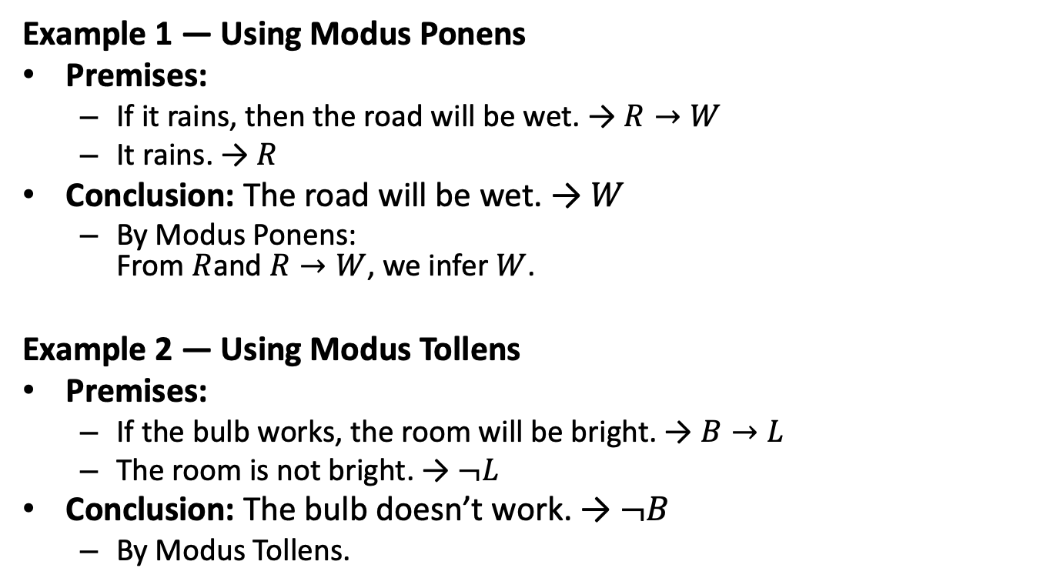
Examples of Rules 1
Example 1 — Using Modus Ponens
Premises:
If it rains, then the road will be wet. → $R→W$
It rains. → $R$
Conclusion: The road will be wet. → $W$
By Modus Ponens: From $R$and $R→W$, we infer $W$.
Example 2 — Using Modus Tollens
Premises:
If the bulb works, the room will be bright. → $B→L$
The room is not bright. → $¬L$
Conclusion: The bulb doesn’t work. → $¬B$
By Modus Tollens.

Slide 10
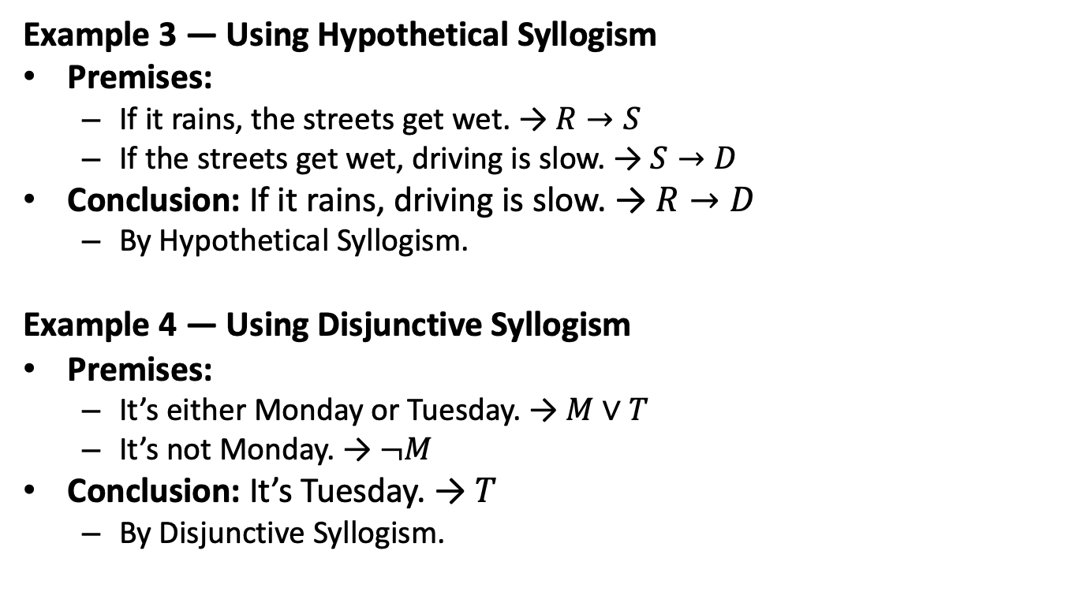
Examples of Rules 2
Example 3 — Using Hypothetical Syllogism
Premises:
If it rains, the streets get wet. → $R→S$
If the streets get wet, driving is slow. → $S→D$
Conclusion: If it rains, driving is slow. → $R→D$
By Hypothetical Syllogism.
Example 4 — Using Disjunctive Syllogism
Premises:
It’s either Monday or Tuesday. → $M∨T$
It’s not Monday. → $¬M$
Conclusion: It’s Tuesday. → $T$
By Disjunctive Syllogism.

Slide 11
Rules of Inference in Predicate Logic
Rule | Form | Meaning / Example
Universal Instantiation (UI) | From ( ∀x P(x) ), infer ( P(c) ). | If all humans are mortal, then Socrates (a human) is mortal.
Universal Generalization (UG) | From ( P(x) ) (for arbitrary x), infer ( ∀x P(x) ). | If we show x² ≥ 0 for any x, we can generalize to all x.
Existential Instantiation (EI) | From ( ∃x P(x) ), infer ( P(c) ) for a new constant c. | If someone is sleeping, let c be a person who is sleeping.
Existential Generalization (EG) | From ( P(c) ), infer ( ∃x P(x) ). | If Socrates is wise, we infer that someone is wise.
Universal Modus Ponens | From ( ∀x (P(x) → Q(x)) ) and ( P(a) ), infer ( Q(a) ). | All birds can fly, Tweety is a bird ⇒ Tweety can fly.
Universal Modus Tollens | From ( ∀x (P(x) → Q(x)) ) and ( ¬Q(a) ), infer ( ¬P(a) ). | All dogs bark; this animal doesn’t bark ⇒ not a dog.

Slide 12
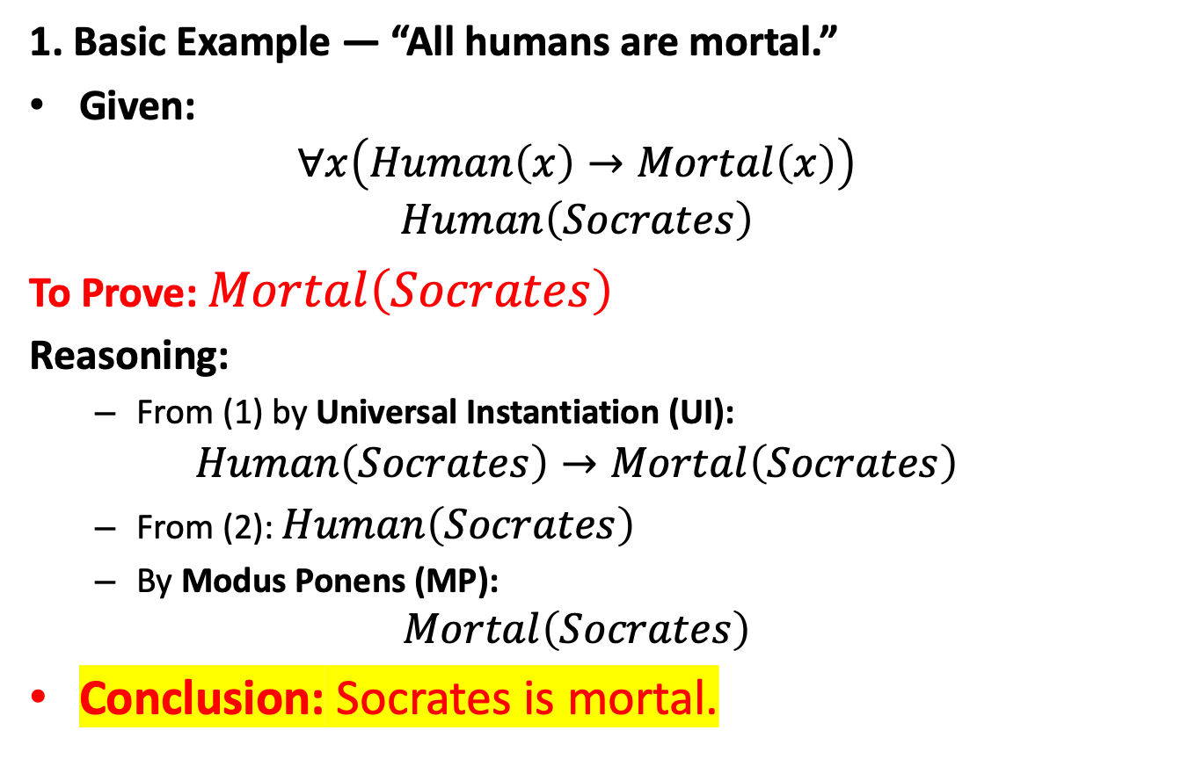
Inference in Predicate Logic (Examples)
1. Basic Example — “All humans are mortal.”
Given:
$$∀x\left(Human\left(x\right)→Mortal\left(x\right)\right)$$
$$Human\left(Socrates\right)$$
To Prove: $Mortal\left(Socrates\right)$
Reasoning:
From (1) by Universal Instantiation (UI): $Human\left(Socrates\right)→Mortal\left(Socrates\right)$
From (2): $Human\left(Socrates\right)$
By Modus Ponens (MP): $Mortal\left(Socrates\right)$
Conclusion: Socrates is mortal.

Slide 13
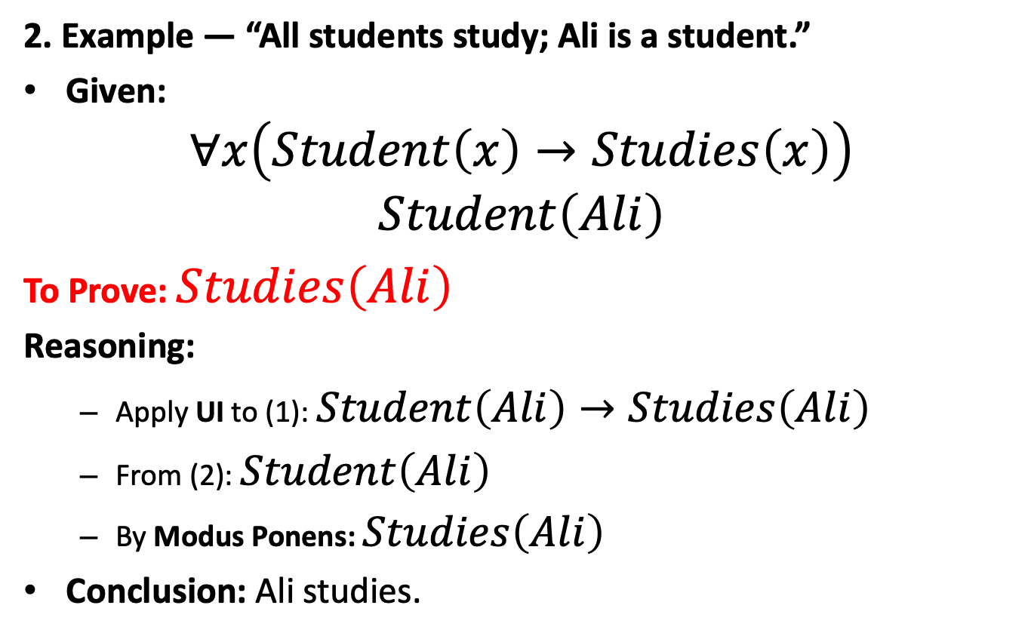
Inference in Predicate Logic (Examples)
2. Example — “All students study; Ali is a student.”
Given:
$$∀x\left(Student\left(x\right)→Studies\left(x\right)\right)$$
$$Student\left(Ali\right)$$
To Prove: $Studies\left(Ali\right)$
Reasoning:
Apply UI to (1): $Student\left(Ali\right)→Studies\left(Ali\right)$
From (2): $Student\left(Ali\right)$
By Modus Ponens: $Studies\left(Ali\right)$
Conclusion: Ali studies.

Slide 14
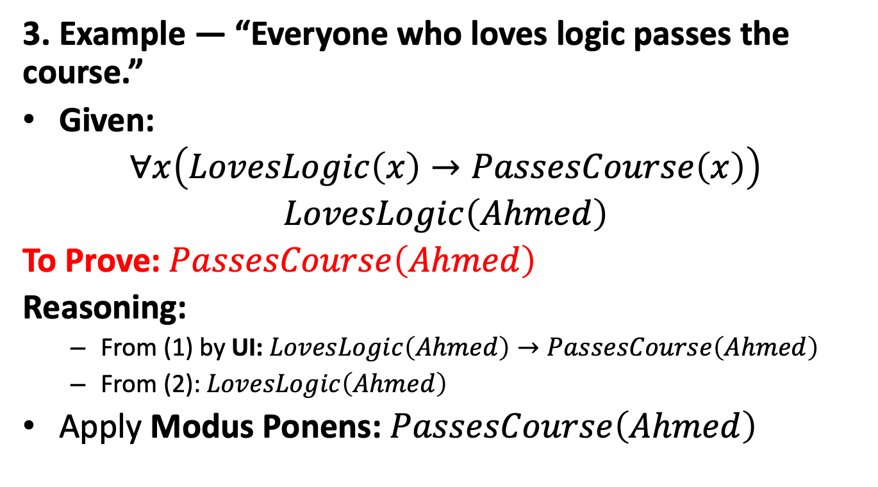
Inference in Predicate Logic (Examples)
3. Example — “Everyone who loves logic passes the course.”
Given:
$$∀x\left(LovesLogic\left(x\right)→PassesCourse\left(x\right)\right)$$
$$LovesLogic\left(Ahmed\right)$$
To Prove: $PassesCourse\left(Ahmed\right)$
Reasoning:
From (1) by UI: $LovesLogic\left(Ahmed\right)→PassesCourse\left(Ahmed\right)$
From (2): $LovesLogic\left(Ahmed\right)$
Apply Modus Ponens: $PassesCourse\left(Ahmed\right)$

Slide 15
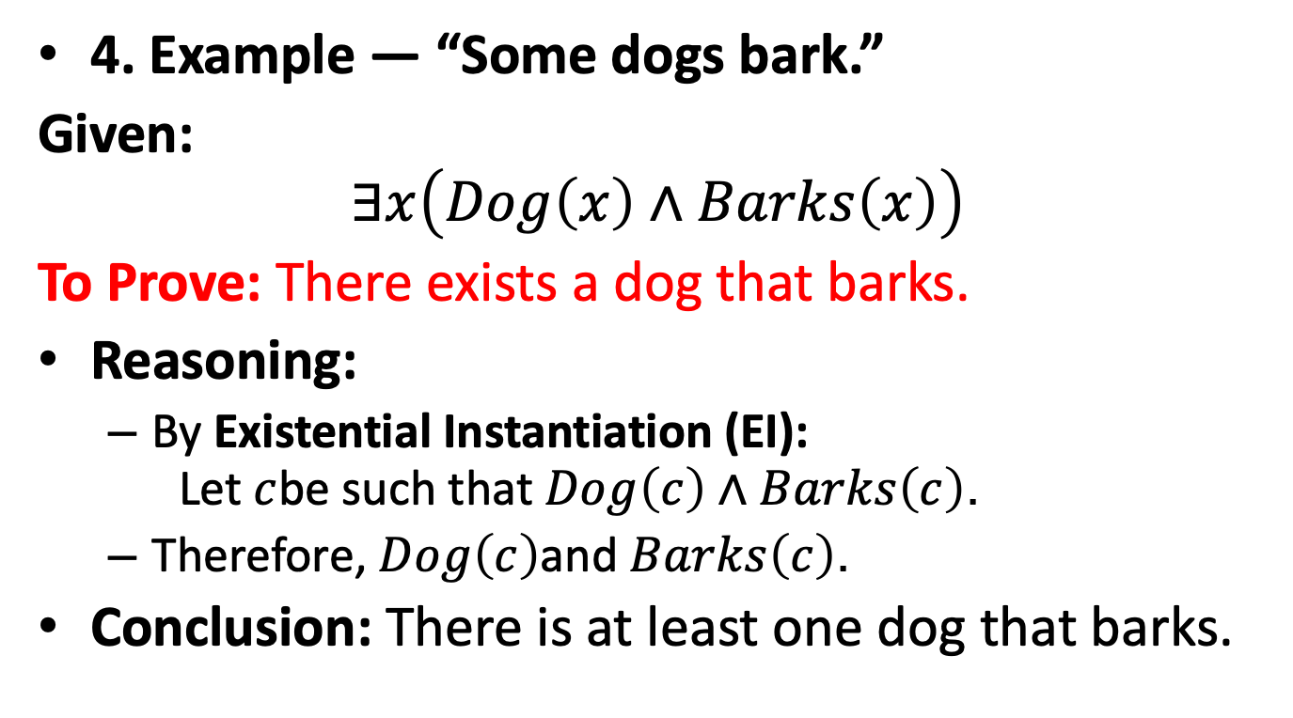
Inference in Predicate Logic (Examples)
4. Example — “Some dogs bark.”
Given: $$∃x\left(Dog\left(x\right)∧Barks\left(x\right)\right)$$
To Prove: There exists a dog that barks.
Reasoning:
By Existential Instantiation (EI): Let $c$be such that $Dog\left(c\right)∧Barks\left(c\right)$.
Therefore, $Dog\left(c\right)$and $Barks\left(c\right)$.
Conclusion: There is at least one dog that barks.

Slide 16
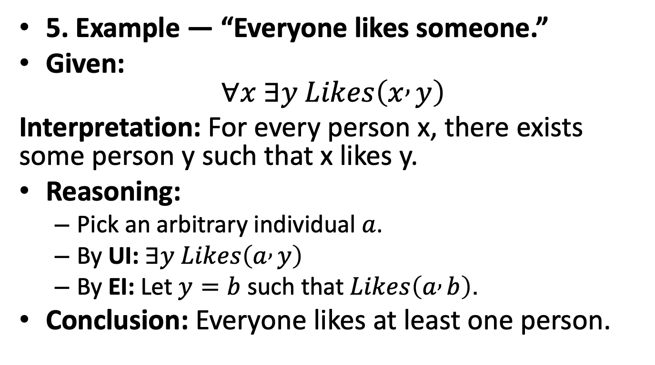
Inference in Predicate Logic (Examples)
5. Example — “Everyone likes someone.”
Given: $∀x ∃y Likes\left(x , y\right)$
Interpretation: For every person x, there exists some person y such that x likes y.
Reasoning:
Pick an arbitrary individual $a$.
By UI: $∃y Likes\left(a , y\right)$
By EI: Let $y=b$ such that $Likes\left(a , b\right)$.
Conclusion: Everyone likes at least one person.

Slide 17
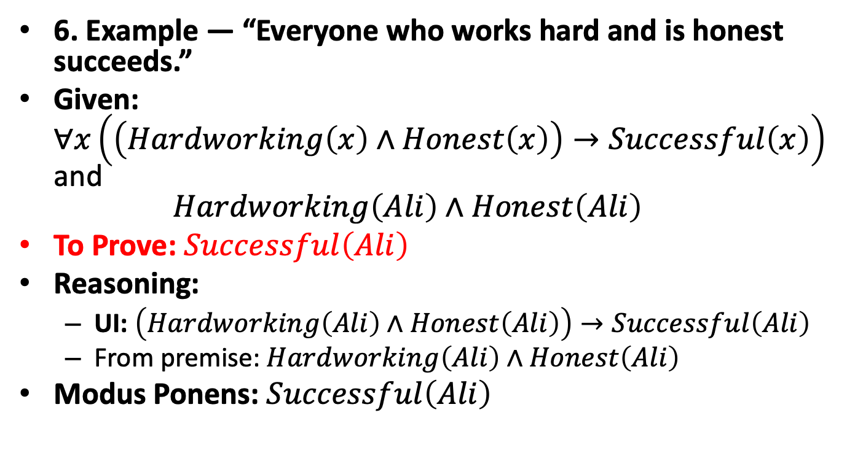
Inference in Predicate Logic (Examples)
6. Example — “Everyone who works hard and is honest succeeds.”
Given: $∀x\left(\left(Hardworking\left(x\right)∧Honest\left(x\right)\right)→Successful\left(x\right)\right)$ and $Hardworking\left(Ali\right)∧Honest\left(Ali\right)$
To Prove: $Successful\left(Ali\right)$
Reasoning:
UI: $\left(Hardworking\left(Ali\right)∧Honest\left(Ali\right)\right)→Successful\left(Ali\right)$
From premise: $Hardworking\left(Ali\right)∧Honest\left(Ali\right)$
Modus Ponens: $Successful\left(Ali\right)$

Slide 18
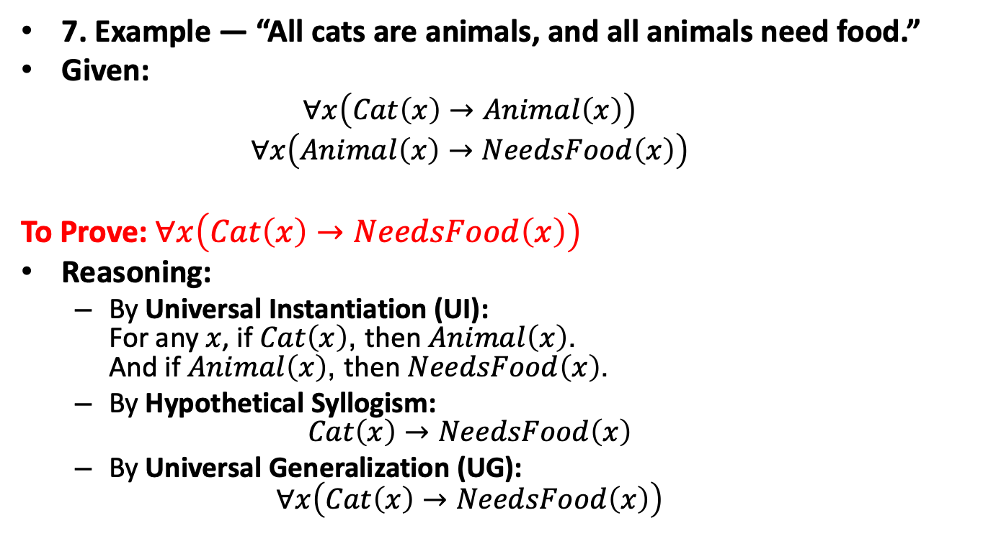
Inference in Predicate Logic (Examples)
7. Example — “All cats are animals, and all animals need food.”
Given:
$$∀x\left(Cat\left(x\right)→Animal\left(x\right)\right)$$
$$∀x\left(Animal\left(x\right)→NeedsFood\left(x\right)\right)$$
To Prove: $∀x\left(Cat\left(x\right)→NeedsFood\left(x\right)\right)$
Reasoning:
By Universal Instantiation (UI): For any $x$, if $Cat\left(x\right)$, then $Animal\left(x\right)$. And if $Animal\left(x\right)$, then $NeedsFood\left(x\right)$.
By Hypothetical Syllogism: $Cat\left(x\right)→NeedsFood\left(x\right)$
By Universal Generalization (UG): $∀x\left(Cat\left(x\right)→NeedsFood\left(x\right)\right)$

Slide 19
Example: The Zeus Argument
Premises:
1. ∀x (Human(x) → Mortal(x))
2. ¬Mortal(Zeus)
To Prove: ¬Human(Zeus)
Proof:
From (1) by UI: Human(Zeus) → Mortal(Zeus)
From (2): ¬Mortal(Zeus)
By Modus Tollens ⇒ ¬Human(Zeus)
✓ Argument is valid.

Slide 20
Question 1
1. Premises:
∀x (Bird(x) → CanFly(x))
¬CanFly(Penguin)
Prove: ¬Bird(Penguin)
Proof:
From (1) by UI: Bird(Penguin) → CanFly(Penguin)
From (2): ¬CanFly(Penguin) By Modus Tollens ⇒ ¬Bird(Penguin)

Slide 21
Question 2
2. Premises:
∀x (Programmer(x) → Logical(x))
¬Logical(John)
Prove: ¬Programmer(John)
Proof:
From (1) by UI: Programmer(John) → Logical(John)
From (2): ¬Logical(John) By Modus Tollens ⇒ ¬Programmer(John) Valid argument.

Slide 22
Question 3
3. Premises:
∀x (Bird(x) → HasWings(x))
∀x (HasWings(x) → CanFly(x))
Bird(Sparrow)
Prove: CanFly(Sparrow)
Proof:
From (1): Bird(Sparrow) → HasWings(Sparrow)
From (2): HasWings(Sparrow) → CanFly(Sparrow)
By HS: Bird(Sparrow) → CanFly(Sparrow)
From (3): Bird(Sparrow)
By MP: CanFly(Sparrow) Valid argument.

Slide 23
Natural Deduction
Natural Deduction is a formal method of reasoning used to derive conclusions from premises using rules of inference that closely follow human logical reasoning.
It was developed by Gerhard Gentzen (1935) as a system to mirror natural human reasoning in a formal structure.
In simple terms:
Natural Deduction is a system for proving that a conclusion logically follows from given premises — step by step, using valid inference rules.

Slide 24
Natural Deduction
Purpose
To prove that a conclusion logically follows from premises.
To derive valid arguments without using truth tables.
To show how the conclusion is obtained, not just that it’s true.
Structure of a Natural Deduction Proof
A proof in Natural Deduction consists of:
Premises (given statements).
Inference steps (applying logical rules).
Conclusion (the final statement proven).

Slide 25
Methods of Proofs
A proof is a logical argument that establishes the truth of a mathematical or logical statement beyond any doubt.
It starts from known facts (axioms or premises) and proceeds step by step using valid rules of inference to reach a conclusion.
A proof is valid if every step logically follows from previous ones using accepted inference rules.
Purpose of Proofs
To demonstrate truth with certainty (not by example or observation).
To explain why a statement is true.
To verify program correctness or mathematical results.
To ensure logical soundness in computer science and AI.

Slide 26
Main Methods of Proof
Direct Proof
Indirect Proof (Contrapositive Proof)
Proof by Contradiction
Proof by Cases
Proof by Mathematical Induction
Proof by Exhaustion
Counterexample (Disproof Method)

Slide 27
1. Direct Proof
A direct proof shows that if the hypothesis (P) is true, then the conclusion (Q) must also be true — directly using logical steps.
Structure:
Assume P is true.
Use definitions, axioms, and inference rules to show Q is true.
Example: Prove: If n is even, then n² is even.
Proof: Let n = 2k for some integer k. Then n² = (2k)² = 4k² = 2(2k²), which is even.

Slide 28
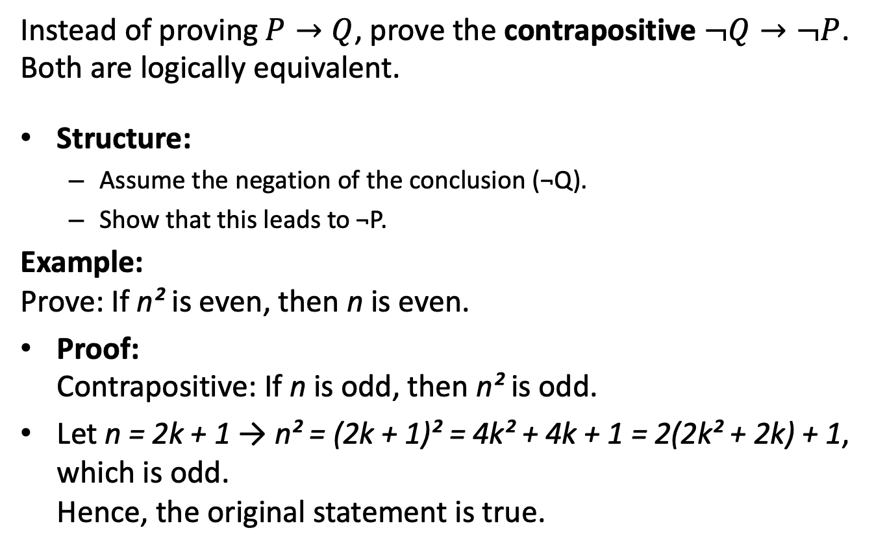
2. Indirect Proof (Contrapositive Proof)
Instead of proving $P→Q$, prove the contrapositive $¬Q→¬P$. Both are logically equivalent.
Structure:
Assume the negation of the conclusion (¬Q).
Show that this leads to ¬P.
Example: Prove: If n² is even, then n is even.
Proof: Contrapositive: If n is odd, then n² is odd.
Let n = 2k + 1 → n² = (2k + 1)² = 4k² + 4k + 1 = 2(2k² + 2k) + 1, which is odd. Hence, the original statement is true.

Slide 29
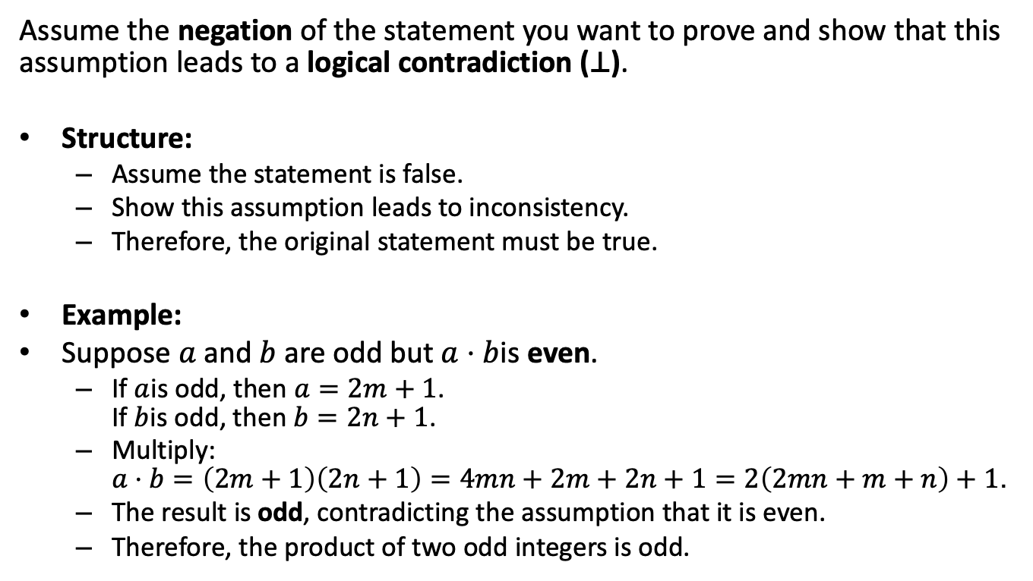
3. Proof by Contradiction
Assume the negation of the statement you want to prove and show that this assumption leads to a logical contradiction (⊥).
Structure:
Assume the statement is false.
Show this assumption leads to inconsistency.
Therefore, the original statement must be true.
Example:
Suppose $a$ and $b$ are odd but $a⋅b$is even.
If $a$is odd, then $a=2m+1$. If $b$is odd, then $b=2n+1$.
Multiply: $a⋅b=\left(2m+1\right)\left(2n+1\right)=4mn+2m+2n+1=2\left(2mn+m+n\right)+1$.
The result is odd, contradicting the assumption that it is even.
Therefore, the product of two odd integers is odd.

Slide 30
4. Proof by Cases
Break the statement into exhaustive cases and prove it holds in each case.
Structure:
Divide into all possible logical cases.
Prove the statement separately for each case.
Example : Prove: For any integer n, n² ≥ 0.
Proof:
Case 1: If n ≥ 0, then n² ≥ 0.
Case 2: If n < 0, then n² = (-n)² ≥ 0.
In both cases, true.

Slide 31
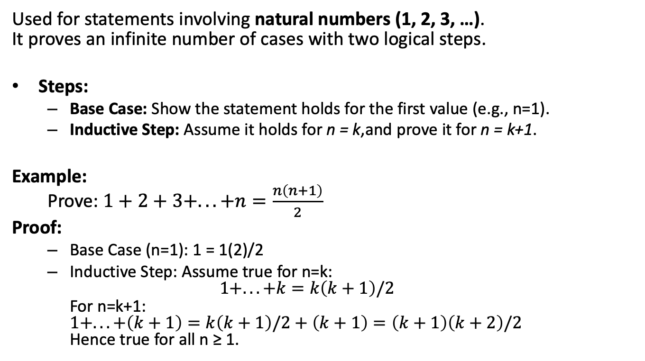
5. Proof by Mathematical Induction
Used for statements involving natural numbers (1, 2, 3, …). It proves an infinite number of cases with two logical steps.
Steps:
Base Case: Show the statement holds for the first value (e.g., n=1).
Inductive Step: Assume it holds for n = k,and prove it for n = k+1.
Example: Prove: $1+2+3+...+n=\frac{n\left(n+1\right)}{2}$
Proof:
Base Case (n=1): 1 = 1(2)/2
Inductive Step: Assume true for n=k: $1+...+k=k\left(k+1\right)/2$ For n=k+1: $1+...+\left(k+1\right)=k\left(k+1\right)/2+\left(k+1\right)=\left(k+1\right)\left(k+2\right)/2$ Hence true for all n ≥ 1.

Slide 32
6. Proof by Exhaustion
Used when the domain is finite — check all possible cases.
Example: Prove: For integers n = 1, 2, 3, the expression n² – n + 41 is prime.
Proof: Compute: n=1 → 41 (prime) n=2 → 43 (prime) n=3 → 47 (prime) All cases true ⇒ statement holds.

Slide 33
7. Counterexample (Disproof Method)
To disprove a universal statement (∀x P(x)), show one example where it’s false.
Example: Disprove: “All even numbers are divisible by 4.”
Counterexample: n = 6 → even but not divisible by 4. ❌ Hence, statement false.

